Slide 1
Tuition Benefit Guidelines AY25 University of Utah – The Graduate School
June 2024

Slide 2
Contents
Updates to the Tuition Benefit Guidelines
Tuition Benefit Structure
Tuition Benefit Types – Updated Support Types
The Waiver System
Removed/Updated Rules
Academic Year Credit Hour limit – Adjustment
Reviewing the Updated Entry Process
Previewing Planned Updated Reports

Slide 3
Updates to the Tuition Benefit Guidelines

Slide 4
Tuition Benefit Types
Waived Tuition Benefits (WTB): tuition being written off by the University, representing reduced tuition revenue; this includes resident tuition & mandatory fees, and the nonresident waiver where applicable.
Sponsored Tuition Benefits (STB): reduction of tuition by way of billing resident tuition and mandatory fees to a sponsoring funding source, which includes research grants, faculty startup packages, donor funds, department discretionary funds, returned F&A, etc.; the University will waive the nonresident waiver where applicable.

Slide 5
Tuition Benefit Structure
Tuition Benefit Program
Waived Tuition Benefits
Individual student waivers provided to each college
Sponsored Tuition Benefits
RAs billed to F&A (not charged to a chartfield)
Resident tuition charged to a chartfield (research grants, faculty startup packages, etc.)

Slide 6
Revising Tuition Support Types
Research assistants – RA (GR will be retired)
Teaching assistants – TA (GT will be retired)
Graduate fellows – GF
Traineeships – TR (this is new, separating fellows from trainees)
New graduate assistant job code for non-TBP supported TAs & RAs: 1632

Slide 7
Switch to Waiver System
Eliminate dollar-based allocations – these are hard for programs and colleges to balance in relation to student need, they can be restrictive of student enrollments
Waivers streamline TBP calculations: 1 student = 1 waiver
Waivers will cover up to 12 graduate credits (and as little as 3 credits of thesis or dissertation)
Waived Tuition Benefits (WTB) covers TAs, RAs with payroll on activities, GFs, and TRs
Additionally, we are eliminating fractional benefits (50% and 75% TB)

Slide 8
AY25 Waivers
Projections are based on the number of students served for AY24
Similar to allocations, waivers are a college resource that is distributed between programs at the dean of the college’s discretion
Final budgets/waiver counts are under review at this time. We are working with the budget office to confirm that information and once it is set, that will be shared with college deans to determine individual department distribution.

Slide 9
Removing Restrictive Rules
The following rules will be eliminated from TBP at-large; however, college leadership will have the opportunity to determine college-specific rules for TBP usage.
Will now follow Office of the Registrar definitions of full-time enrollment
84 credit hour rule for RAs will be eliminated
First degree restriction eliminated
Semester limits eliminated

Slide 10
Increase to 30 Credits AY
Move from coverage of 24 graduate credits AY to 30 graduate credits AY (12 credits fall | 12 credits spring | 6 credits summer)
Change will allow for students to maximize enrollment each semester and be able to utilize summer – may help enable students to complete their programs on a more efficient timeline
Please note: Office of the Registrar policy notes that students who are on campus and utilizing University facilities during the summer should be enrolled in courses

Slide 11
The New Entry Portal

Slide 12
NOTE
Everything in the following slides is still under development. What we are showing today includes the desired end-goal for the new entry process and reports.
However, some elements of the following may be subject to change.
We appreciate your flexibility at this time, and we will be sure to inform coordinators of any process changes from this desired outcome as UIT finalizes production.

Slide 13
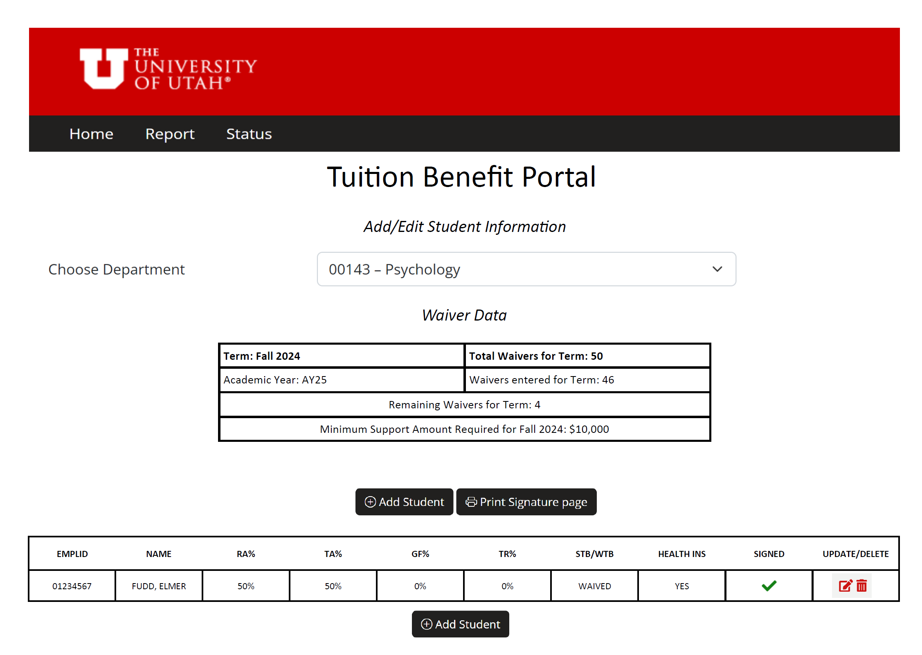
The New Entry Portal – Landing Page

Slide 14
The New Entry Portal – Landing Page

Slide 15
The New Entry Portal – Landing Page

Slide 16
The New Entry Portal – Landing Page
What’s new here?
Allocation information has been changed to Waiver information
Waiver information will be shown by term
Remaining waivers will be shown clearly for ease of use
Entry information has been updated to include the new support types and whether a student is marked as “Waived” or “Sponsored”

Slide 17
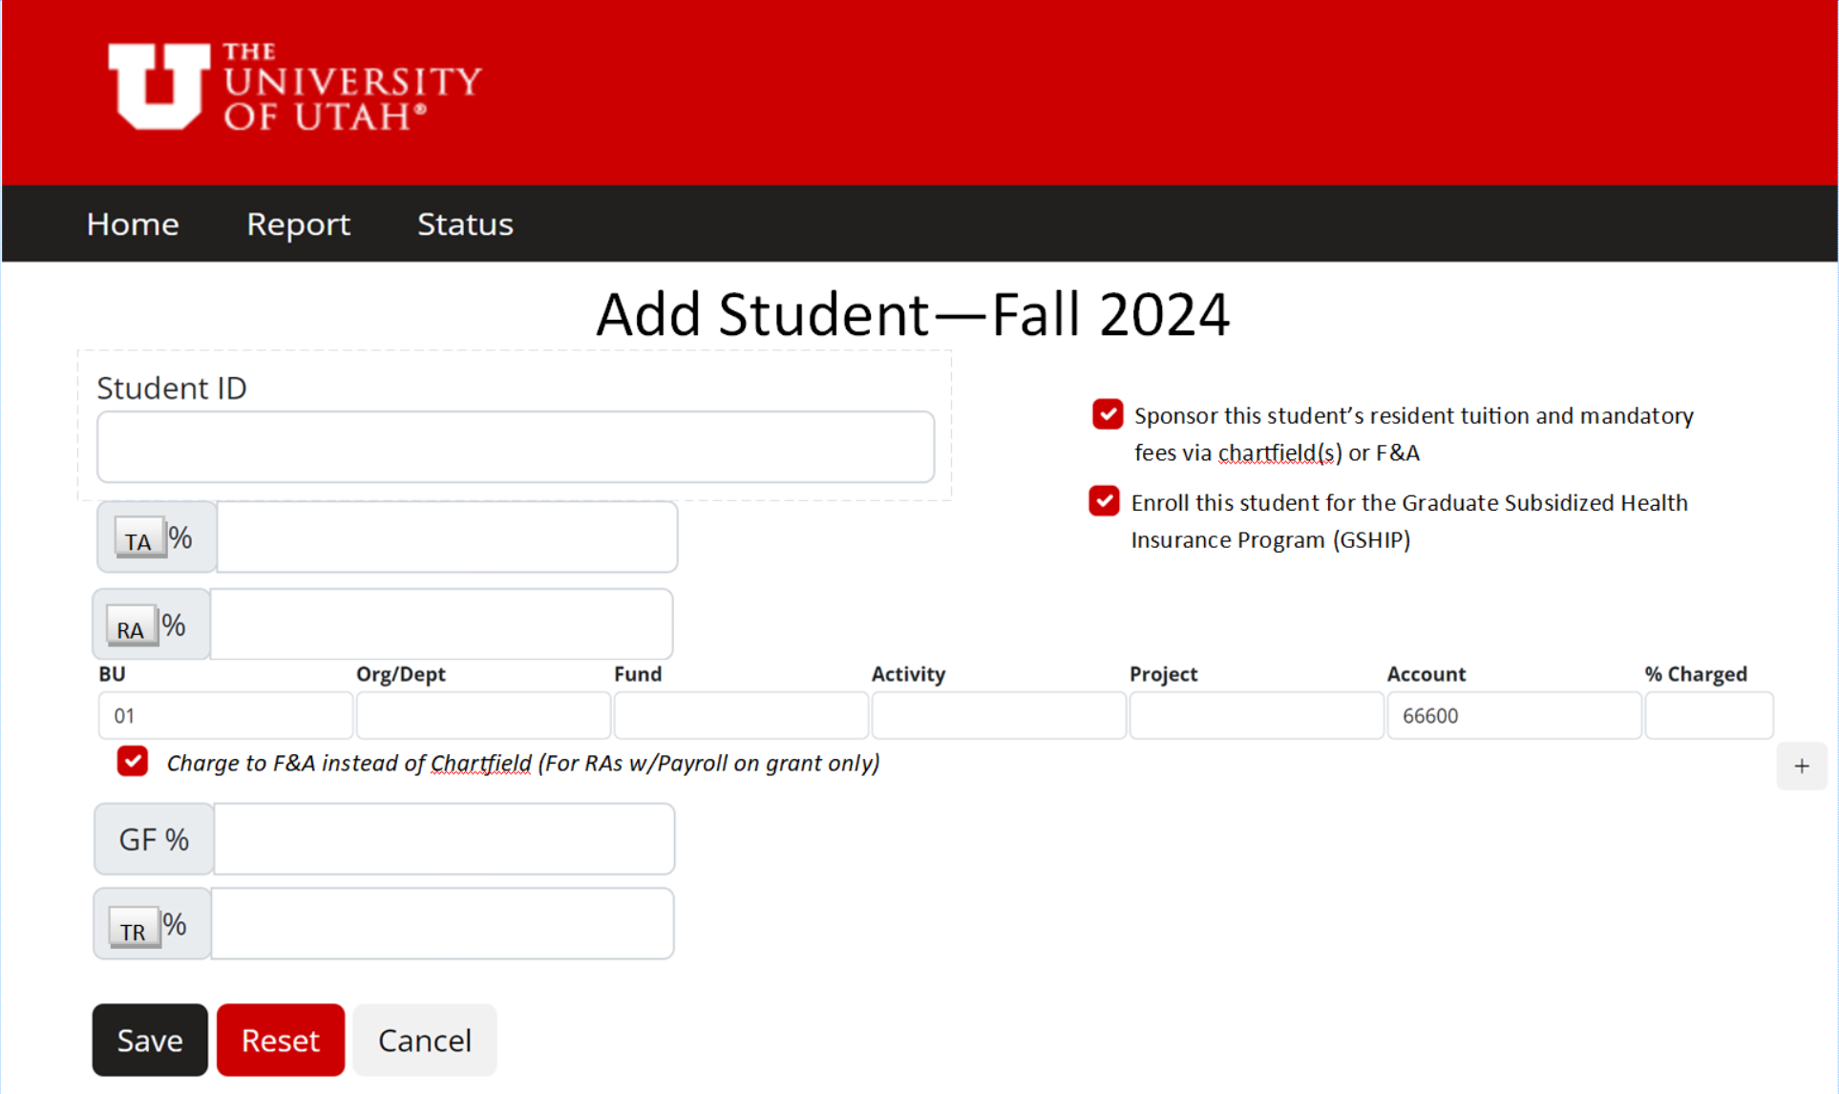
The New Entry Portal – Entry Page

Slide 18
The New Entry Portal – Entry Page

Slide 19
The New Entry Portal – Entry Page

Slide 20
The New Entry Portal – Entry Page
What’s new here?
Minimum support amount is removed as all students will have the same requirements for 100% TB
Support types have been updated to reflect changes
XTBP entry has been updated to reflect new wording for “Sponsored Tuition Benefit”
Both GSHIP and Sponsored tuition benefit options have added wording for clarity
The option to designate RA students with payroll on grants to have their resident tuition and mandatory fees charged to F&A returned overhead instead of using a waiver.

Slide 21
Entry Process Timeline
Portal entry will remain at 6 weeks prior to the first day of courses.
Portal closure will remain the day of Census
GSHIP enrollment will still occur as rapidly as possible after TB entry (students must still meet all requirements for GSHIP enrollment for me to complete the process- minimum enrollment requirement, signed TB agreement, assistant support type, marked for GSHIP during TB entry)
The email students receive prompting them to sign their TB agreement will be automatically sent overnight (up to 24 hours after entry). This change is put in place to allow time for coordinators to make edits/deletions prior to the email, preventing students from receiving confusing/incorrect information. (Students can still manually sign their TB agreement without the email via their student homepage).
Tuition Benefit will still disburse approximately 1 week prior to the first day of courses.

Slide 22
NOTE - Reminder
Everything in the following slides is still under development. What we are showing today includes the desired end-goal for the new entry process and reports.
However, some elements of the following may be subject to change or will be delivered in multiple stages over the next year.

Slide 23
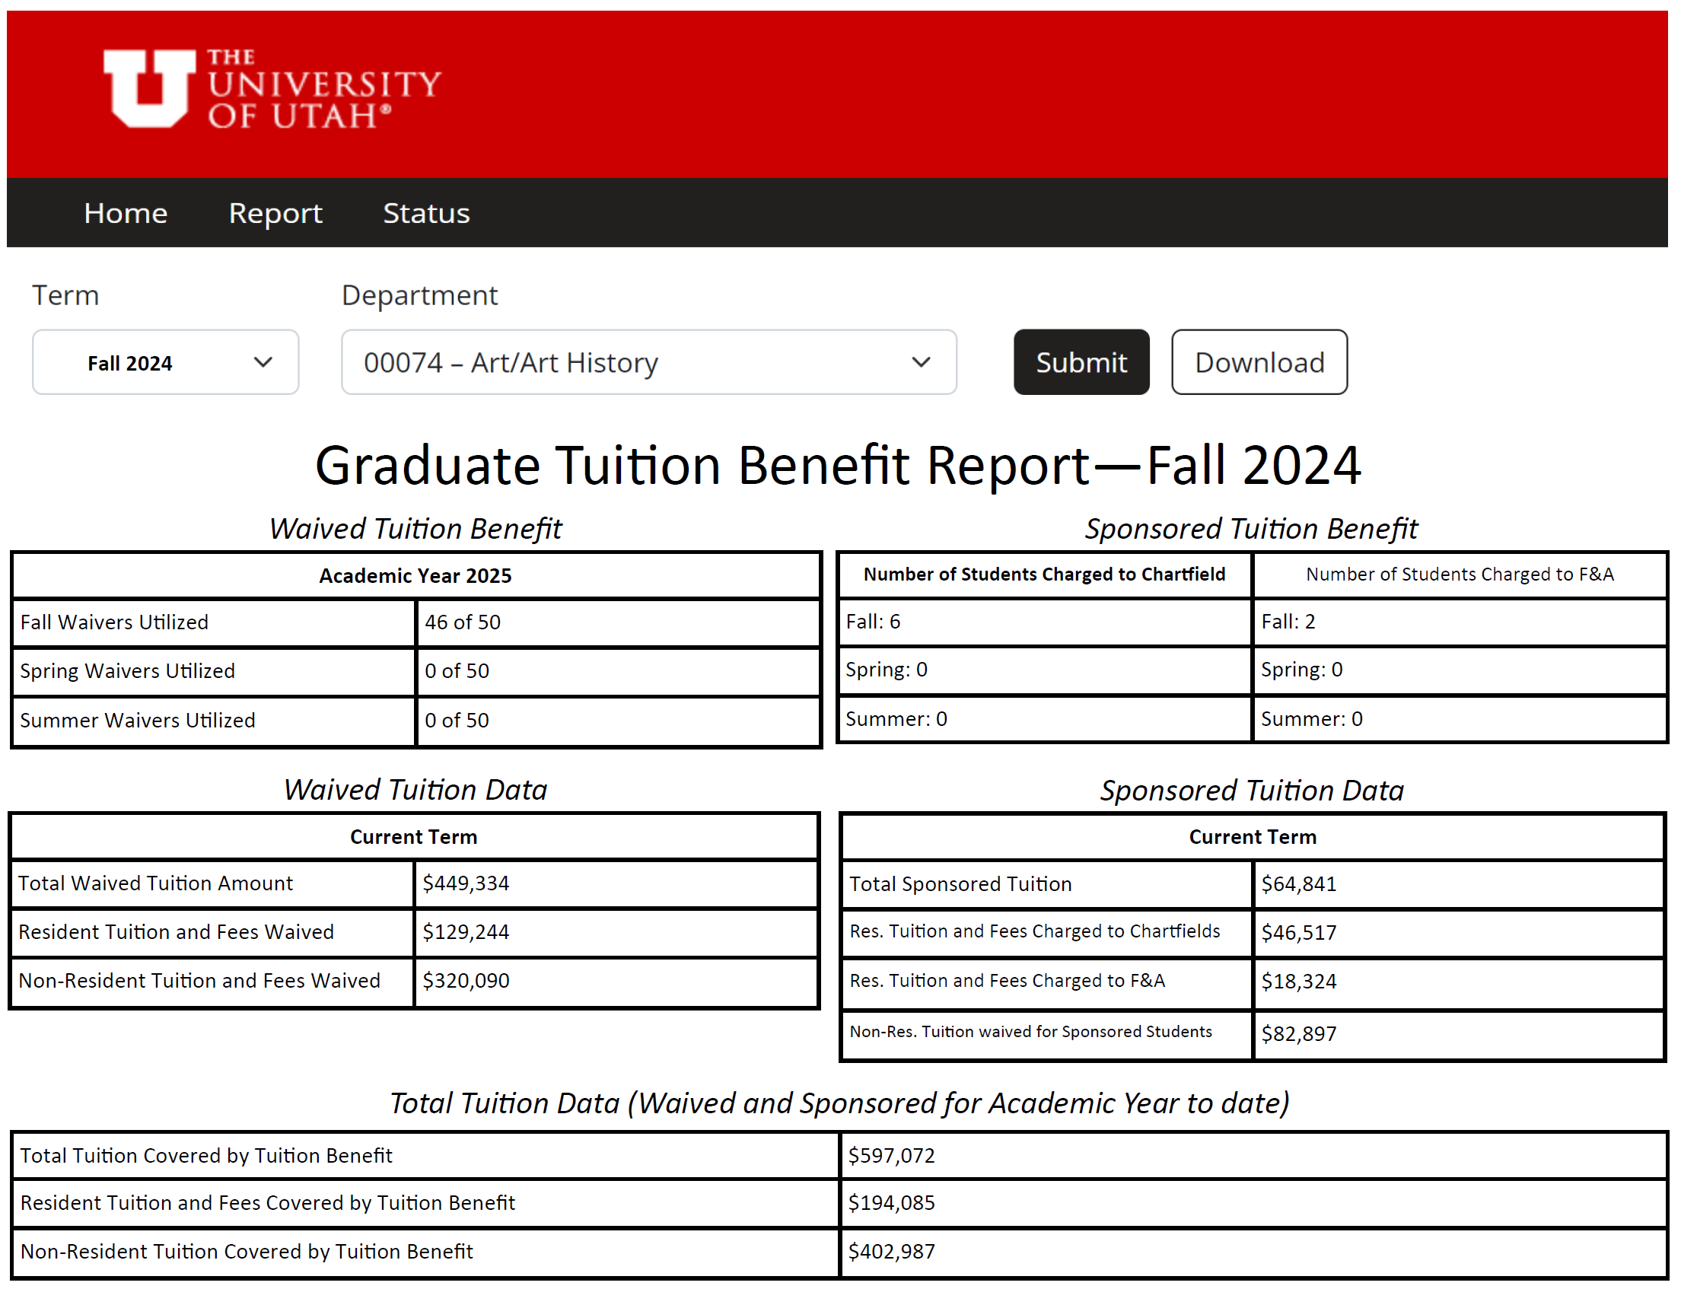
New Report Page – Preview 1

Slide 24
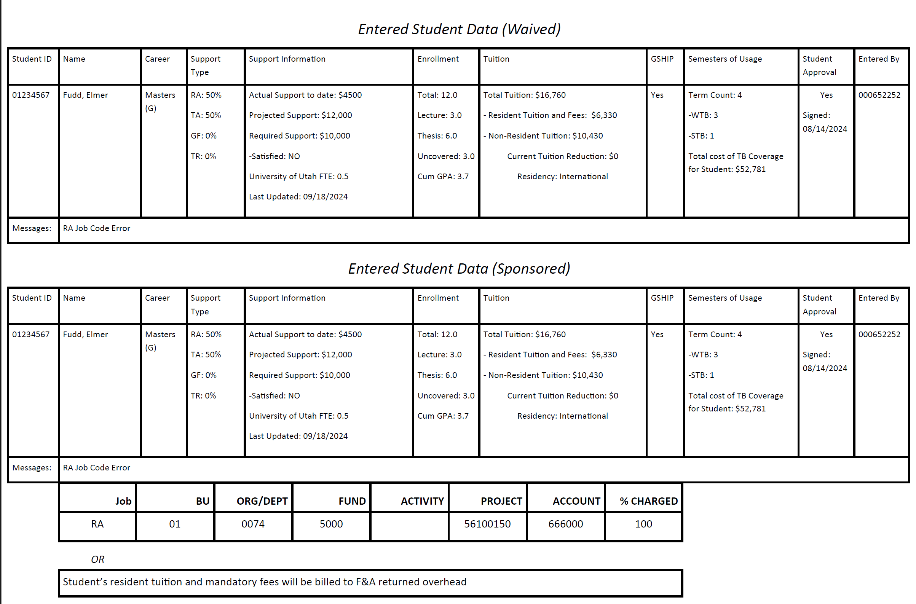
New Report Page – Preview 2

Slide 25
Planned/Requested Updates for the Reports
More clear information regarding tuition coverage, especially for Sponsored tuition benefit which is charged to provided chartfields or F&A returned overhead.
More clear enrollment data for students, including breaking down uncovered (undergraduate) credits.
Semesters of TB usage outlined for department review.
Annual information, updated as the year progresses for better use in department decision making and future planning.

Slide 26
GSHIP – A Quick Note
We are under a new contract for AY25 – United Healthcare Student Resources will remain our medical insurer
Plan currently sitting with the Utah Insurance Department
We’ll have our typical annual materials to share in due course, but those have not yet been provided to us
Premium costs will increase by ~1.3%
New plan feature: Tiered Prescription benefit
No more submitting reimbursements manually!

Slide 27
FAQs

Slide 28
Summer Enrollment & TB
Is summer enrollment required now?
No, summer enrollment is not required in a general sense.
Our increase from 24 credits of coverage in an academic year to 30 credits of coverage is an effort to make summer tuition benefit support more possible for students/departments.

Slide 29
Summer Enrollment & TB
Do students who are working during the summer need to be enrolled?
This is not a Graduate School policy, but an Office of the Registrar rule. The policy states that students who are utilizing university resources during any given semester (summer included), which includes faculty/PI time for student projects and milestones, need to be enrolled/paying tuition as appropriate. An important question to ask is “While doing this work, is the individual acting as a student? An employee? Both?”

Slide 30
Annualized Requirement?
What is the “annualized” requirement that is shown on the minimum support levels? Do students need to be supported all year round now?
No, students do not need to be supported all year round. Your department can still enact its own discretion when selecting which semesters a student is on tuition benefit.
The annualized amount shown on the website is a summation of the minimum support levels for the academic year (shown as both 9 months of support and a full 12 months of support). This is purely a resource to help your department know an expected cost for salary wages/fellowship support that is required over the entire academic year, should you be supporting a student during that entire time.

Slide 31
Differentials?
Will differentials be shown in TB reports?
That is a suggestion we are still reviewing at this time. While we want to include as much helpful information in the reports as we possibly can, we also don’t want to introduce unclear or confusing data points. Since differential tuition is not covered by tuition benefit, including it in our report data may create some additional confusion. As such, we are unsure if there is a way to effectively include it in the report data at this time. This conversation will be ongoing with UIT as we move forward.

Slide 32
GF and GSHIP?
Are GF/TR students GSHIP eligible now?
No, these students are still not eligible for GSHIP enrollment via tuition benefit. However, you can still consider covering them via department paid insurance.

Slide 33
Traineeships and job codes?
Is there a job code for the TR designation?
No, these students are not set up via payroll. Their support is instead disbursed via AP monthly stipends. As such, there will be no associated job code.

Slide 34
Q&A Dates
Wednesday, June 26, 10-11:30am
Tuesday, July 2, 10-11:30am
Thursday, July 18, 1-2:30pm
Wednesday, August 7, 10-11:30am
Wednesday, August 14, 2-3:30pm
A video version of this presentation will be available online for review. Our intention is to have that uploaded by the end of this week.

Slide 35
Questions/Contact
Matthew Plooster, EdD
Office of Fellowships & Benefits
The Graduate School
801-581-6020
matthew.plooster@utah.edu
LoGan Gowers
Office of Fellowships & Benefits
The Graduate School
801-585-1372
L.Gowers@utah.edu
Terrie Parker
Director, Accounting & Finance
The Graduate School
801-585-6213
terrie.parker@utah.edu
tuitionbenefit@gradschool.utah.edu
gradschool.utah.edu/funding/tbp

